Slide 1
Eagle CAD Workshop (1)
Common Rules for Schematic Design

Slide 2
Common Rules for Schematic Design
Use Component Designators
Clear up text
High Top Low Bottom (HTLB)
Left-to-Right
Common Subcircuits
Direct connections
Visualization
Short and concise names
UPPER CASES
Dots Connects, Crosses Don’t (DCCD)

Slide 3
Use Component Designators!
Will talk more about this in first few files.
ASME Y14.44-2008 or IEEE 315-1975 How to properly reference and annotate.
To name a few…
C is for Capacitor
F is for Fuse
R is for Resistor
J is for Jack
P is for Plug
Etc…

Slide 4
Clear Up Text!
If your symbol is pointing like this…
If you happen to rotate your symbol…
Label
Label

Slide 5
High Top Low Bottom!
High Top
…Means Higher voltages should placed on top of a schematic
Low Bottom
…Means Lower voltages should placed on bottom of a schematic

Slide 6
Left-to-Right
Flow of schematics, regardless of logic or power, should be moving from left to right.
Combined with HTLB, power flow schematics will have general direction of top-left to bottom-right.

Slide 7

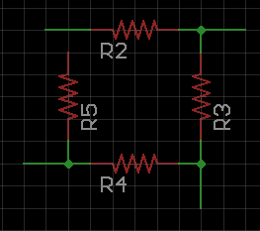
Common Subcircuits!
Which circuit look familiar to you?
If you are deciphering, its bad schematic.

Slide 8
Direct Connections!
If possible, make direct connections as many as possible.
If size is limited, that is fine; make isolated connection, but…

Slide 9
Visualization!
…Label your nets if they are ISOLATED!
Any net/wire that are isolated from actual circuit, MUST be labelled to follow.

Slide 10
Short and Concise Names!
Let’s say a resistor with two different name…
10k 5% Resistor for current limiting
R1 10k 5%
Which would look more clear when placed in a schematic

Slide 11
UPPER CASES!
Obvious reason, this allows components and nets/wires to stick out from schematics.
You can use small cases for comments; just make sure to use UPPER CASES even when you are writing components in comments!
Component u1 is microcontroller
Component U1 is microcontroller

Slide 12
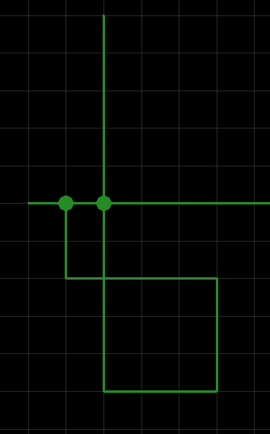
Dots connect, Crosses Don’t
If you see dots between two or more nets, they are connected.
If two or more nets are crossed, they are NOT connected.

